Slide 1
DCG Assignment: Alarm Clock
Mohammed Maier Amir

Slide 2
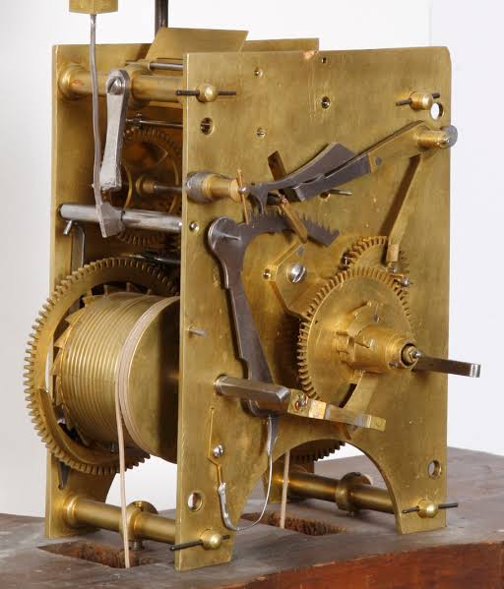
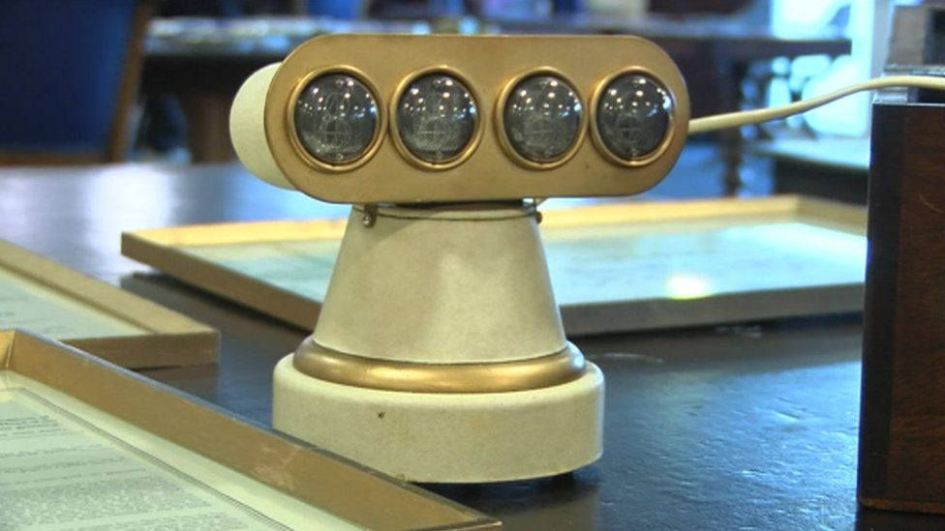
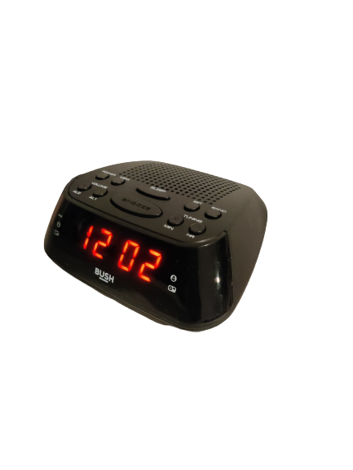
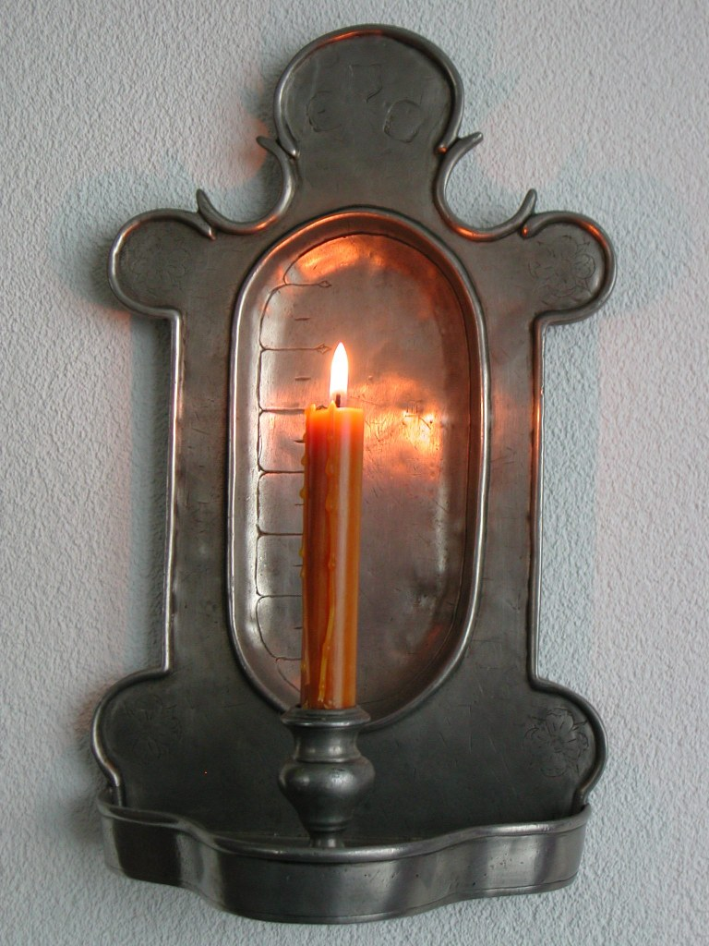
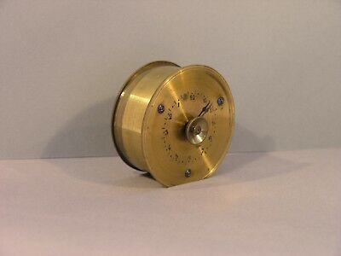


Output 1: Timeline
Primary Research =
Secondary Research =
Candle Clocks
First Adjustable Alarm Clock
Modern Clocks
Modern day clocks include a wide range of features such as Bluetooth, easy to read LCD displays, radio alarms and much more. Most clocks are made from high quality plastic.
The earliest method known to measure time, Nails where placed in a burning candle and would fall on a metal plate making a loud noise
In 1847, Antoine Redier invented the first adjustable alarm clock. It had compact and an easy to use design with round metallic construction
1787
AD 520
1781
1847
1961
Present Day
First Alarm Clock
First digital Clock
Created by Levi Hutchins, this clock’s primary function was to wake him up at 4 a.m. for work. It was hardwired to only ring at 4 am. It had a complex and impractical design.
Created by Thomas Bromley in his garage. The first clock to feature a small, easy to read electrical display and a coned base.

Slide 3
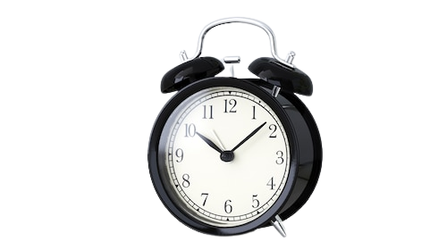
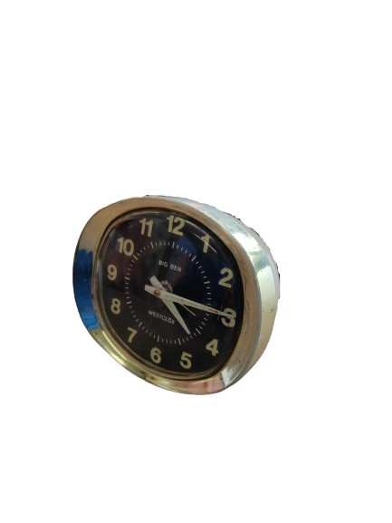
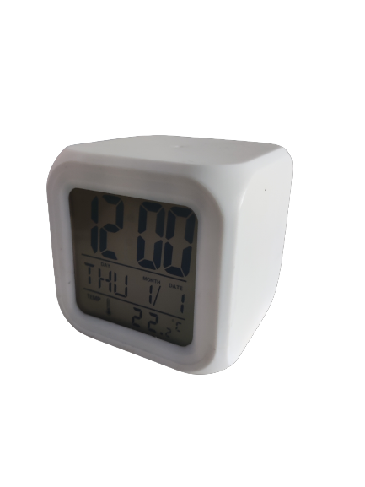
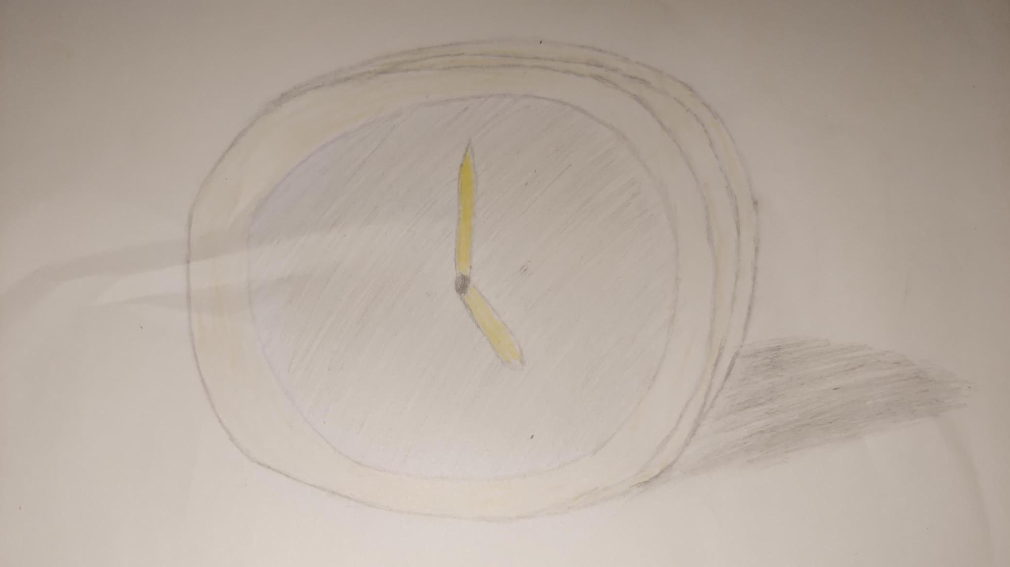
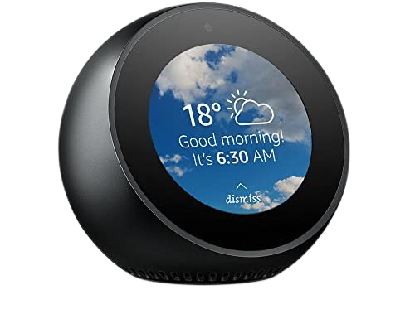
Output 1: Design Research
BRIEF
Bedside alarm clocks are primarily designed to wake people from their sleep at a particular time. They come in analogue, digital and more recently in smart form. Their shape and form is underpinned by a wide variety of geometry and they are available in a range of materials and colours. Some alarm clocks can be turned off in innovative ways. Design features of a bedside alarm clock may include time display, snooze buttons, programmable alarm options, Bluetooth, etc.
(a) Carry out a design investigation of existing bedside alarm clocks in graphic format. Your investigation should include an analysis of physical forms and shapes, geometry, materials, innovation, etc.
Primary Research =
Secondary Research =
Sketch =
Colours
Alarm clocks come in a variety of different colours, the most common being black and white. These generic colours allow the clock to blend in well with it’s environment.
Snooze Features
Snooze allows the user to turn off and play the alarm after a short period of time. The location of the button is of great importance as it determines the functionality of the button. A snooze button on the bottom of the clock would be futile. Some modern clocks may feature a voice controlled snooze.
Shape and design
The majority of alarm clocks use basic geometric shapes such as cubes, cylinders, and spheres. However, some may use more complex designs, such as antique alarm clocks.
Materials
Most alarm clocks have a plastic construction, some also use metals. A plastic build allows for a lower price. Whereas, a metal construction ensures the electrical components are secure. Modern clocks use a mixture of plastics and resin, which is both durable and affordable. Older analog clocks usually feature a steel construction. Steel is used for the bells to sound the alarm.
Display
Digital Clocks usually feature a 7-segment LCD screen which displays the time. Smart clocks may include a HD touchscreen display, allowing the user to interact with the clock to access different types of information other than the time, such as the weather. Analog clocks use a glass or acrylic screen to show the time.
Innovative Features
Smart clocks are alarm clocks that contain many new innovative features such as, touchscreen displays, speakers and Bluetooth to play music, voice control, radio connectivity and much more. All of these features combine to create a seamless and personal experience. It also allows for access to multiple pieces of information from one place.

Slide 4
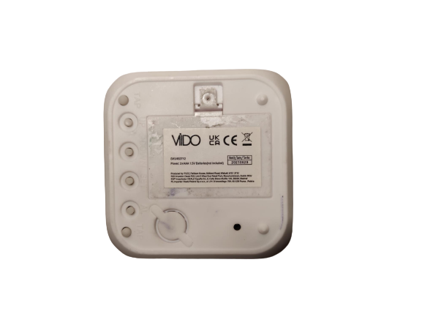
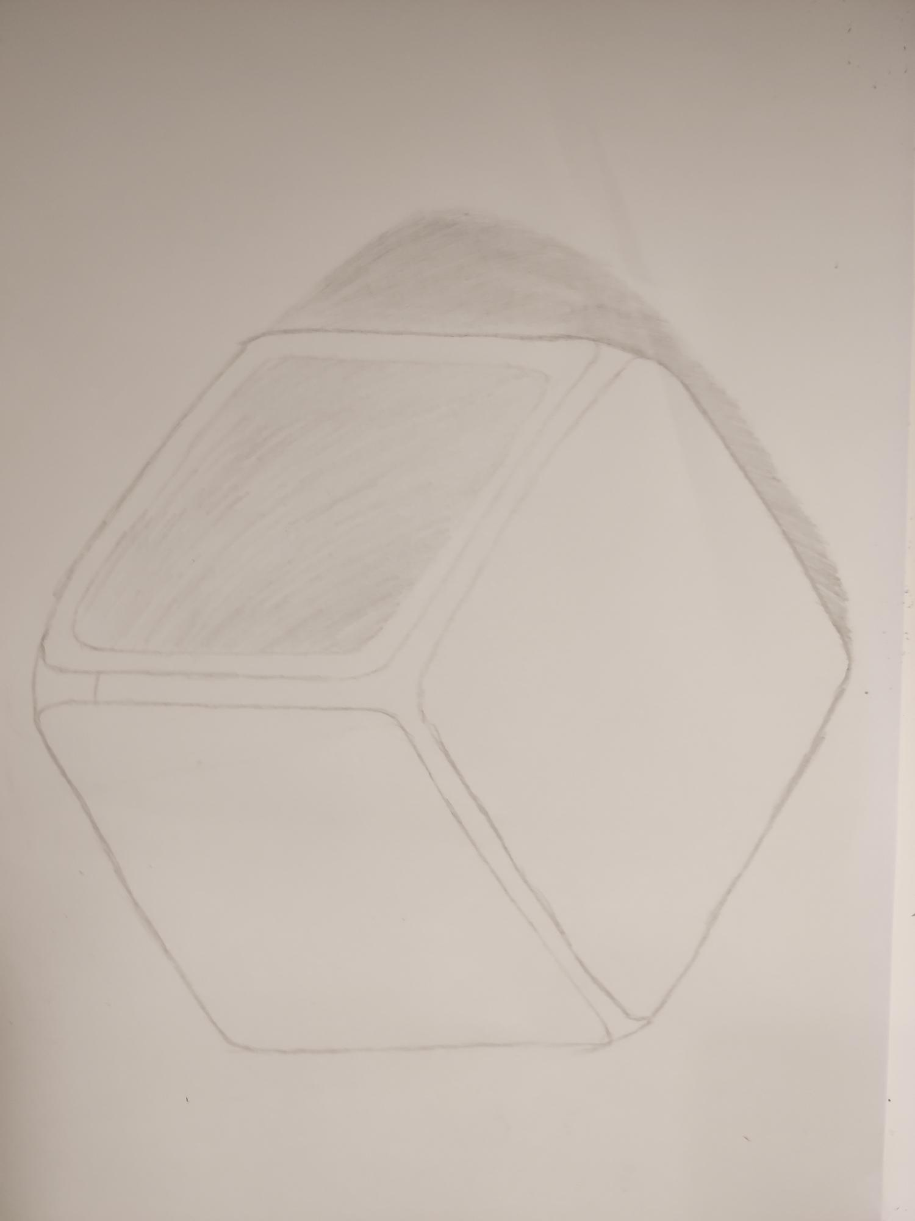
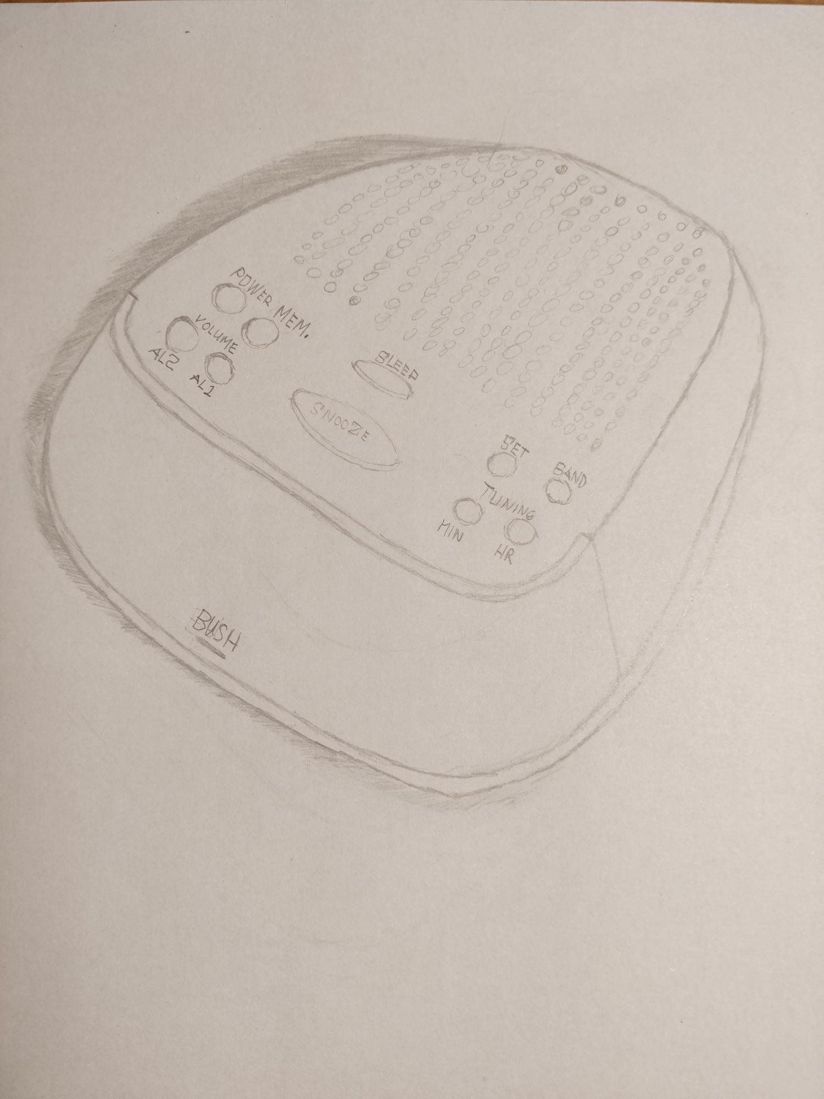
Output 1: Digital clock vs Bush Alarm Clock Design Comparison
Primary Research = Sketch =
Secondary Research =
General Design and Shape
The Bush clock features a complex and sloped design. The sloped shape allows for better viewing of the display. The peculiar shape allows the clock to stand out from it’s surroundings. In contrast, the Digital clock features a basic cube shape with soft edges. The simple design allows the clock to blend in with it’s surroundings. However, the cubed shape does not allow for great viewing angles. In my opinion, the digital alarm clock is more attractive as it features a more simplistic design.
Display
The Bush alarm clock utilizes a sloped LCD display. It displays the time in a bright red colour, this allows for easy viewing of the display even in a dark environment. On the other hand, the digital clock also features a lcd display but one that’s a lower quality and has a worse viewing angle. The lack of colour on the display, makes it harder to read during the night.
80mm
80mm
80mm
Snooze Button
Digital Alarm clock
Materials
Both clocks have a plastic construction. However, the Bush clock features a much more durable and sturdier plastic. Whereas, the digital clock feels weaker and lighter. Stronger materials ensures that the electronics within the clock are secure and don’t break.
Innovative Features
The Bush clock’s stand out feature is it’s ability to connect to radio stations instead of using traditional alarm tones. Its’s interesting design also differentiates it from other clocks. It also has the ability to set up 2 different alarms simultaneously. Allowing 2 different people to utilize it. On the other hand, the digital clock contains a thermometer to give a reading of the room temperature. It also contains an led light which allows it to act as a night light. In my opinion, The Bush clock is far superior in terms of features and usability, as it contains features such as the radio, which I would take advantage of.
Snooze Buttons
One of the major downsides to the digital clock, is the positioning of the snooze button. Located at the bottom of the clock, it is highly impractical as it would be difficult to turn off the alarm since the button is so small. Luckily, the Bush alarm clock features a snooze button at the top of the clock, a very practical and easy to reach location. In addition, the sloped design will allow even easier access, especially during night time. I believe, the snooze button on Bush alarm clock is better primarily due to its reachability.
Snooze Button
50mm
125mm
80mm
Bush Alarm Clock

Slide 5
Bibliography
1. Kim, A., 2022. What materials are used to make an alarm clock? – Theburningofrome.com. [online] Theburningofrome.com. Available at: <https://www.theburningofrome.com/advices/what-materials-are-used-to-make-an-alarm-clock/> [Accessed 13 October 2022].
2. Segan, S., 2022. Amazon Echo Spot. [online] PCMag UK. Available at: <https://uk.pcmag.com/smart-home/92057/amazon-echo-spot> [Accessed 18 October 2022].
3. En.wikipedia.org. 2022. Digital clock - Wikipedia. [online] Available at: <https://en.wikipedia.org/wiki/Digital_clock> [Accessed 15 October 2022].
4. 2022. Candle Clock: Studying its History, Facts, and Limitations. [online] Available at: <https://historyplex.com/candle-clock-history-facts-limitations> [Accessed 10 October 2022].
5. En.wikipedia.org. 2022. Candle clock - Wikipedia. [online] Available at: <https://en.wikipedia.org/wiki/Candle_clock> [Accessed 10 October 2022].
6. Tropicalísima 13-50. 2022. Formas de levantarse antes del invento del despertador. [online] Available at: <https://www.imer.mx/tropicalisima/formas-de-levantarse-antes-del-invento-del-despertador/> [Accessed 11 October 2022].
7. En.wikipedia.org. 2022. Alarm clock - Wikipedia. [online] Available at: <https://en.wikipedia.org/wiki/Alarm_clock> [Accessed 13 October 2022].
8. Pinterest.com.au. 2022. Adjustable Clock. [online] Available at: <https://www.pinterest.com.au/pin/inventions--492651646745720035/> [Accessed 13 October 2022].
9. thetimekit. 2022. A BRIEF HISTORY OF ALARM CLOCKS: A JOURNEY FROM FIRST ALARM CLOCKS TO MODERN ONES. [online] Available at: <https://thetimekit.com/blog/a-brief-history-of-alarm-clocks-a-journey-from-first-alarm-clocks-to-modern-ones#:~:text=In%201847%2C%20Antoine%20Redier%2C%20a,needed%20to%20wake%20up%20at.> [Accessed 14 October 2022].
10. BBC News. 2022. The clock that cost its inventor millions. [online] Available at: <https://www.bbc.com/news/uk-england-humber-46252838> [Accessed 14 October 2022].
11 Amazon.com.au. 2022. Amazon alexa. [online] Available at: <https://www.amazon.com.au/Amazon-Smart-speaker-screen-Alexa/dp/B074BMLG1V> [Accessed 15 October 2022].
12. IKEA. 2022. DEKAD Alarm clock, low-voltage/black, 10 cm - IKEA Ireland. [online] Available at: <https://www.ikea.com/ie/en/p/dekad-alarm-clock-low-voltage-black-30540479/> [Accessed 15 October 2022].

